Slide 1
CS8651 INTERNET PROGRAMMING
UNIT II CLIENT SIDE PROGRAMMING
Java Script: An introduction to JavaScript–JavaScript DOM Model-Date and Objects,-Regular Expressions- Exception Handling-Validation-Built-in objects-Event Handling- DHTML with JavaScript
JSON introduction – Syntax – Function Files – Http Request – SQL.

Slide 2
COURSE OUTCOMES (CO)
COURSE OBJECTIVES
1. To understand different Internet Technologies
2. To learn java-specific web services architecture
CO 1 | Students will be able to construct a basic website using HTML and Cascading Style Sheets.
CO 2 | Students will be able to build dynamic web page with validation using Java Script objects and by applying different event handling mechanisms.
CO 3 | Students will be able to develop server side programs using Servlets and JSP.
CO 4 | Students will be able to construct simple web pages in PHP and to represent data in XML format.
CO 5 | Students will be able to use AJAX and web services to develop interactive web applications

Slide 3
Course Delivery Plan
UNIT II CLIENT SIDE PROGRAMMING
Session # | Topic
1 | An introduction to JavaScript
2 | JavaScript DOM Model
3 | Date and Objects - Regular Expressions
4 | Exception Handling-Validation-Built-in objects
5 | Event Handling- DHTML with JavaScript
6 | JSON introduction – Syntax
7 | Function Files
8 | Http Request
9 | SQL

Slide 4
Java Script
An introduction to JavaScript
JavaScript DOM Model
Date and Objects
Regular Expressions
Exception Handling
Validation
Built-in objects
Event Handling
DHTML with JavaScript

Slide 5
Introduction to JavaScript
JavaScript is an interpreted programming or script language
Invented in 1995 at Netscape Corporation
JavaScript programs are run by an interpreter built into the user's web browser (not on the server)
Client side scripting

Slide 6
What is JavaScript?
JavaScript was designed to add interactivity to HTML pages
JavaScript is a scripting language
A JavaScript consists of lines of executable computer code
A JavaScript is usually embedded directly into HTML pages
JavaScript is an interpreted language
Everyone can use JavaScript without purchasing a license

Slide 7
What can a JavaScript Do?
JavaScript gives HTML designers a programming tool
JavaScript can put dynamic text into an HTML page
JavaScript can react to event
JavaScript can read and write HTML elements
JavaScript can be used to validate data
JavaScript can be used to detect the visitor's browser
JavaScript can be used to create cookies

Slide 8
Java vs. JavaScript
Requires the JDK to create the applet
Requires a Java virtual machine to run the applet
Applet files are distinct from the XHTML code
Source code is hidden from the user
Programs must be saved as separate files and compiled before they can be run
Programs run on the server side
Requires a text editor
Required a browser that can interpret JavaScript code
JavaScript can be placed within HTML and XHTML
Source code is made accessible to the user
Programs cannot write content to the hard disk
Programs run on the client side

Slide 9
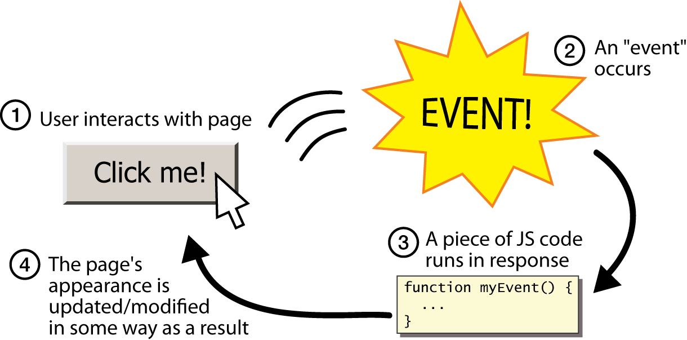
Event-driven programming
split breaks apart a string into an array using a delimiter
can also be used with regular expressions (seen later)
join merges an array into a single string, placing a delimiter between them

Slide 10
Event-driven Programming
JavaScript programs wait for user actions called events and respond to them
Event-driven Programming: writing programs driven by user events

Slide 11
Javascript Syntax
To embed a client-side script in a Web page, use the element: <script> script commands and comments </script>
To access an external script, use: <script src=“url”> script commands and comments </script>

Slide 12
Javascript Syntax
<script>
statement-1;
statement-2;
….
statement-n;
</script>

Slide 13
Where to Put the JavaScript
<head> section
Save file with extension .html
<body> section
Save file with extension .html
External scripts
Save file with extension .js

Slide 14
JavaScript in the <head> section
<html>
<head>
<title>Java Script Example</title>
<script>
alert("Hello World!");
</script>
</head>
<body>
</body>
</html>

Slide 15
Scripts in the <body> section
<html>
<head>
<title>Java Script Example</title>
</head>
<body>
<script>
alert("Hello World1");
</script>
</body>
</html>

Slide 16
Using External JavaScript
<html>
<head>
<script src=“extfile.js">
</script>
</head>
<body>
</body>
</html>
extfile.js
alert("Hello");
alert (“Welcome to Javascript”);
alert (“Have a nice day!”);

Slide 17
Comments
The syntax for a single-line comment is:
// comment text
The syntax of a multi-line comment is:
/* comment text covering several lines */

Slide 18
Writing Output to a Web Page
JavaScript displays data in the following ways:
document.write() or document.writeln()
window.alert() or alert()
innerHTML

Slide 19
Types of Variables
JavaScript supports Four different types of variables:
Numeric variables can be a number
13, 22.5, or -3.14159
String variables is any group of characters
“Hello” or “Happy Holidays!”
Boolean variables are variables that accept one of two values
true or false
null variables is a variable that has no value at all

Slide 20
Declaring a Variable
Declare a variable using the var keyword or by assigning the variable a value
Any of the following commands is a legitimate way of creating a variable named “Month”:
var Month;
var Month = “December”;
Month = “December”;
var age=20;

Slide 21
Javascript Functions
Syntax
function name()
{
statement ;
statement ;
...
statement ;
}
Example
<script>
function MyFunction()
{
alert("Hello!");
alert("How are you?");
}
</script>

Slide 22
JavaScript DOM Model
What is DOM?
The Document Object Model (DOM) is a programming API for HTML and XML documents.
It defines the logical structure of documents and the way a document is accessed and manipulated.
With the Document Object Model, programmers can create and build documents, navigate their structure, and add, modify, or delete elements and content

Slide 23
Nodes Organise the Page
<html>
<head>
<title>My page</title>
</head>
<body>
<p>This text is on my page</p>
</body>
</html>
html
head
title
text
“my page”
body
p
text
“This text is on my page”

Slide 24
What is a Node?
Element Node – contains an HTML tag
Text Node – contains text
Text Nodes are contained in Element Nodes

Slide 25
DOM Methods
document.createElement()
document.createTextNode()
appendChild()
removeChild()
document.getElementById()
document.getElementsByTagName()
document.getElementsByClassName()
getAttribute()
setAttribute()
innerHTML

Slide 26
Adding Some Text to a Page
There are five steps:
Create a new Element
Create new Text
Append the new Text to the new Element
Find an existing Element
Append the new Element to the existing Element

Slide 27
1. Create New Element Node
Create a new <p> tag (element) so that we can attach some text to it
Put the new object into a variable
var newNode;
newNode = document.createElement(“p”);

Slide 28
2. Create a Text Node
Create a text node
Put the new text node into a variable
var newText;
newText = document.createTextNode(“Some text”);

Slide 29
3. Attach the New Text Node to the New Element
To put the text into the page, we have to attach the text node to the new HTML element:
newNode.appendChild(newText);

Slide 30
4.Find an Existing Element
The new element with our text node attached to it is still floating around in a Javascript world.
Assign this existing element to a variable
var docElement;
docElement = document.getElementById(“thisLocation”);

Slide 31
5. Append the New Element to the Existing Element
To insert our text into the page, we now have to append the new element to the existing element
docElement.appendChild(newNode);

Slide 32
Putting the 5 Steps Together
<html>
<head>
<script>
var myText;
myText = "This is new text to be added to the page dynamically.";
function addText(location)
{
var newNode;
var newText;
var docElement;
newNode = document.createElement("p");
newText = document.createTextNode(myText);
newNode.appendChild(newText);
docElement = document.getElementById(location);
docElement.appendChild(newNode);
}
</script>
</head>
<body>
<p>
<a href="#" onclick="addText('thisLocation');">Click to add new text to the page</a></p>
<p id="thisLocation">New text will appear below here</p>
<p>Some further text in the page</p>
</body>
</html>

Slide 33
Remove a Node
To remove a node, we use the element method removeChild(name of node to be removed)
For example:
function remText(location)
{
var docElement;
docElement = document.getElementById(location);
docElement.removeChild(docElement.lastChild);
}

Slide 34
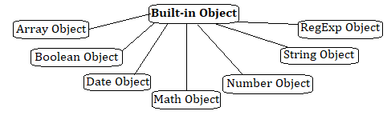
Javascript Built-in objects

Slide 35
Date Object
There are two ways to create a date object
Method-1 var-name = new Date(“month day, year, hours:minutes:seconds”) ;
Method-2
var-name = new Date(year, month, day, hours, minutes, seconds);
var-name is the name of the variable that contains the date information
month, day, year, hours, minutes, and seconds indicate the date and time
Example:
var Today=new Date(“October 15, 2006”);
var Today=new Date(2006, 9, 15);

Slide 36
Date Object and Methods
Date object can be used to access the date and time, and to perform "date arithmetic"
To get and set current Date and Time
today = new Date();
new Year = new Date(2002,0,1);
Methods of Date object
Date() - Returns today's date and time
getDate() - Returns the day of the month for the specified date
getDay() - Returns the day of the week for the specified date
getFullYear() - Returns the year of the specified date
getHours() - Returns the hour in the specified date according to local time.
getMilliseconds() - Returns the milliseconds in the specified date according to local time.

Slide 37
<!DOCTYPE html>
<html>
<head>
<title>Date Object Example</title>
</head>
<body>
<pre>
<script>
d=new Date();
document.writeln(d);
document.writeln("getDate() return:"+d.getDate());
document.writeln("getDay() returns:"+d.getDay());
document.writeln("getFullYear() returns:"+d.getFullYear());
document.writeln("getHours() returns:"+d.getHours());
document.writeln("getMinutes() returns:"+d.getMinutes());
document.writeln("getSeconds() returns:"+d.getSeconds());
document.writeln("getMilliseconds() returns:"+d.getMilliseconds());
</script>
</pre>
</body>
</html>

Slide 38
Array Object
Multiple values are stored in a single variable using the Array object.
In JavaScript, an array can hold different types of data types in a single slot, which implies that an array can have a string, a number or an object in a single slot.
An Array object can be created by using following ways:
Using the Array Constructor
Using the Array Literal Notation

Slide 39
Array Object
Using the Array Constructor:
To create empty array when don’t know the exact number of elements to be inserted in an array
var arrayname = new Array();
To create an array of given size
var arrayname = new Array(size);
To create an array with given elements
var arrayname = new Array(“element 1”,”element 2”,……..,”element n”);

Slide 40
Array Object
Using the Array Literal Notation:
To create empty array
var arrayname =[ ];
To create an array when elements are given
var arrayname =[“element 1”,”element 2”,……..,”element n”];

Slide 41
Array Object
Properties of the Array object
length - Returns the number of elements in the array
Constructor - Returns the function that created the Array object
Prototype - Add properties and methods to an object
Methods of the Array object
reverse() - Reverses the array elements
concat() - Joins two or more arrays
sort() - Sort the elements of an array
push() - Appends one or more elements at the end of an array
pop() - Removes and returns the last element
shift() - Removes and returns the first element

Slide 42
Array Object Example-1
<!DOCTYPE html>
<html>
<head>
<title>Array Object Example</title>
</head>
<body>
<pre>
<script>
a=new Array(3);
a.push(10);
a.push(20);
a.push(30);
document.writeln(a.pop());
document.writeln(a.pop());
document.writeln(a.pop());
</script>
</pre>
</body>
</html>

Slide 43
Array Object Example-2
<!DOCTYPE html>
<html>
<head>
<title>Array Object Example</title>
</head>
<body>
<pre>
<script>
a=new Array(3);
b=['aaa','bbb','ccc']
a[0]=10;
a[1]=20;
a[2]=30;
document.writeln(a[0]);
document.writeln(a[1]);
document.writeln(a[2]);
document.writeln(b[2]);
</script>
</pre>
</body>
</html>

Slide 44
Array Object Example-3
<!DOCTYPE html>
<html>
<head>
<title>Array Example-2</title>
<script>
function book(title, author)
{
this.title = title;
this.author = author;
}
</script>
</head>
<body>
<script>
var myBook = new book("Perl", “Ramesh");
book.prototype.price = null;
myBook.price = 100;
document.write("Book title is : " + myBook.title + "<br>");
document.write("Book author is : " + myBook.author + "<br>");
document.write("Book price is : " + myBook.price + "<br>");
</script>
</body>
</html>

Slide 45
Array Object Example-3
<!DOCTYPE html>
<html>
<head>
<title>Array Object Example - Methods and Properties</title>
</head>
<body>
<pre>
<script>
a=new Array(3);
a.push(10);
a.push(30);
a.push(20);
document.writeln(a.pop());
document.writeln(a.pop());
document.writeln(a.pop());
b=[20,10,15];
document.writeln("Before Sorting:"+b);
b.sort();
document.writeln("After Sorting:"+b);
document.writeln("Length:"+b.length);
document.writeln("Constructor:"+b.constructor);
document.writeln(b.shift());
alpha = ["a", "b", "c"];
numeric = [1, 2, 3];
alphaNumeric = alpha.concat(numeric);
document.writeln("alphaNumeric : " + alphaNumeric );
document.writeln("Reverse of alpha: " + alpha.reverse());
</script>
</pre>
</body>
</html>

Slide 46
Math Object
The JavaScript Math object is used to perform mathematical tasks.
The Math object is a static built-in object, so no need to instantiate it, all its properties and methods can be accessed directly.

Slide 47
Math Object Example
<!DOCTYPE html>
<html>
<head>
<title>Math Object Example</title>
</head>
<body>
<pre>
<script>
document.writeln("PI="+Math.PI);
document.writeln("3 to the Power of 2="+Math.pow(3,2));
</script>
</pre>
</body>
</html>

Slide 48
Math Properties
Property | Description
E | Returns Euler's number, the base of natural logarithms, e, approximately 2.718
LN2 | Returns the natural logarithm of 2, approximately 0.693
LN10 | Returns the natural logarithm of 10, approximately 2.302
LOG2E | Returns the base 2 logarithm of e, approximately 1.442
LOG10E | Returns the base 10 logarithm of e, approximately 0.434
PI | Returns the ratio of the circumference of a circle to its diameter (i.e. π). The approximate value of PI is 3.14159
SQRT1_2 | Returns the square root of 1/2, approximately 0.707
SQRT2 | Returns the square root of 2, approximately 1.414

Slide 49
Math Methods
Method | Description
abs() | Returns the absolute value of a number.
acos() | Returns the arccosine of a number, in radians.
acosh() | Returns the hyperbolic arccosine of a number.
asin() | Returns the arcsine of a number, in radians
asinh() | Returns the hyperbolic arcsine of a number.
atan() | Returns the arctangent of a number, in radians.
atan2(y, x) | Returns the arctangent of the quotient of its arguments.
atanh() | Returns the hyperbolic arctangent of a number.
cbrt() | Returns the cube root of a number.
ceil() | Returns the next integer greater than or equal to a given number (rounding up).

Slide 50
Math Methods(cont..)
Method | Description
cos() | Returns the cosine of the specified angle. The angle must be specified in radians.
cosh() | Returns the hyperbolic cosine of a number.
exp(x) | Returns e^{x}, where x is the argument, and e is Euler's number (also known as Napier's constant), the base of the natural logarithms.
floor() | Returns the next integer less than or equal to a given number (rounding down).
log() | Returns the natural logarithm (base e) of a number.
max(x, y, ...) | Returns the highest-valued number in a list of numbers.
min(x, y, ...) | Returns the lowest-valued number in a list of numbers.
pow(x, y) | Returns the base to the exponent power, that is, x^{y}.

Slide 51
Math Methods(cont..)
Method | Description
random() | Returns a random number between 0 and 1 (including 0, but not 1).
round() | Returns the value of a number rounded to the nearest integer.
sin() | Returns the sign of a number (given in radians).
sinh() | Returns the hyperbolic sine of a number.
sqrt() | Returns the square root of a number.
tan() | Returns the tangent of a number.
tanh() | Returns the hyperbolic tangent of a number.
trunc(x) | Returns the integer part of a number by removing any fractional digits.

Slide 52
JS String Object
String Properties
Property | Description
constructor | Returns the string's constructor function
length | Returns the length of a string
prototype | Allows you to add properties and methods to an object

Slide 53
JS String Object
String Methods
Method | Description
charAt() | Returns the character at the specified index (position)
charCodeAt() | Returns the Unicode of the character at the specified index
concat() | Joins two or more strings, and returns a new joined strings
endsWith() | Checks whether a string ends with specified string/characters
fromCharCode() | Converts Unicode values to characters
includes() | Checks whether a string contains the specified string/characters
indexOf() | Returns the position of the first found occurrence of a specified value in a string
lastIndexOf() | Returns the position of the last found occurrence of a specified value in a string
localeCompare() | Compares two strings in the current locale
match() | Searches a string for a match against a regular expression, and returns the matches
repeat() | Returns a new string with a specified number of copies of an existing string
replace() | Searches a string for a specified value, or a regular expression, and returns a new string where the specified values are replaced

Slide 54
JS String Object
String Methods
Method | Description
search() | Searches a string for a specified value, or regular expression, and returns the position of the match
slice() | Extracts a part of a string and returns a new string
split() | Splits a string into an array of substrings
startsWith() | Checks whether a string begins with specified characters
substr() | Extracts the characters from a string, beginning at a specified start position, and through the specified number of character
substring() | Extracts the characters from a string, between two specified indices
toLocaleLowerCase() | Converts a string to lowercase letters, according to the host's locale
toLocaleUpperCase() | Converts a string to uppercase letters, according to the host's locale
toLowerCase() | Converts a string to lowercase letters
toUpperCase() | Converts a string to uppercase letters
trim() | Removes whitespace from both ends of a string
valueOf() | Returns the primitive value of a String object

Slide 55
JS String Object
<!DOCTYPE html>
<html>
<head>
<title>String Object Example</title>
</head>
<body>
<script>
msg="Welcome to Javascript";
document.writeln("String Length:"+msg.length);
document.writeln("<br>Position of script:"+msg.search("script"));
document.writeln("<br>String Before Replace:"+msg);
document.writeln("<br>String After Replace:"+msg.replace("Java","Perl"));
</script>
</body>
</html>

Slide 56
JavaScript Objects
JavaScript objects are containers for named values called properties or methods
Objects are variables too
But objects can contain many values

Slide 57
JavaScript Objects
Creating Object
var person = {
firstName:"John",
lastName:"Doe",
age:50,
eyeColor:"blue“,
fullName:function()
{
return this.firstName+ “ “ + this.lastName;}
};
Accessing Object Methods and Properties
var name=person.fullName();
var myAge=person.age;

Slide 58
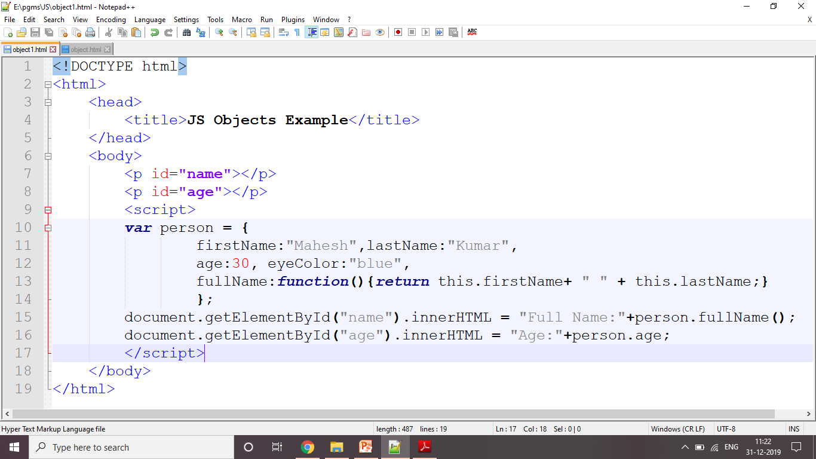
JS Object Example

Slide 59
Regular Expressions
A regular expression is a sequence of characters that forms a search pattern
The search pattern can be used for text search and text replace operations
When you search for data in a text, you can use this search pattern to describe what you are searching for
A regular expression can be a single character, or a more complicated pattern
Regular expressions can be used to perform all types of text search and text replace operations

Slide 60
Regular Expressions
Components
Modifiers
Patterns
Metacharacters
Qunatifiers
Objects

Slide 61
Creating Regular Expression
1. Using a regular expression literal
const re = /ab+c/;
Regular expression literals provide compilation of the regular expression when the script is loaded.
2. Calling the constructor function of the RegExp object
const re = new RegExp('ab+c');
constructor function provides runtime compilation of the regular expression

Slide 62
Writing a regular expression pattern
Using simple patterns
Fimple patterns are constructed to find a direct match
Example: pat= /abc/
Using special characters
Finding one or more characters, or finding white space
Example: pat = /ab*c/

Slide 63
Regular Expressions Syntax
Syntax:
/pattern/modifiers;
new RegExp(“pattern”);
Example:
var patt = /cse/i;
Modifiers
Modifier | Description
i | Perform case-insensitive matching
g | Perform a global match (find all matches rather than stopping after the first match)
m | Perform multiline matching

Slide 64
Regular Expressions
Patterns
Expression | Description
[abc] | Find any character between the brackets
[^abc] | Find any character NOT between the brackets
[0-9] | Find any character between the brackets (any digit)
[^0-9] | Find any character NOT between the brackets (any non-digit)
(x|y) | Find any of the alternatives specified

Slide 65
Regular Expressions
Metacharacters
Metacharacter | Description
. | Find a single character, except newline or line terminator
\w | Find a word character
\W | Find a non-word character
\d | Find a digit
\D | Find a non-digit character
\s | Find a whitespace character
\S | Find a non-whitespace character
\b | Find a match at the beginning/end of a word
\B | Find a match, but not at the beginning/end of a word
\0 | Find a NUL character
\n | Find a new line character
\f | Find a form feed character
\r | Find a carriage return character
\t | Find a tab character
\v | Find a vertical tab character

Slide 66
Regular Expressions
Quantifiers
Quantifier | Description
n+ | Matches any string that contains at least one n
n* | Matches any string that contains zero or more occurrences of n
n? | Matches any string that contains zero or one occurrences of n
n{X} | Matches any string that contains a sequence of X n's
n{X,Y} | Matches any string that contains a sequence of X to Y n's
n{X,} | Matches any string that contains a sequence of at least X n's
n$ | Matches any string with n at the end of it
^n | Matches any string with n at the beginning of it
?=n | Matches any string that is followed by a specific string n
?!n | Matches any string that is not followed by a specific string n

Slide 67
Regular Expressions Methods in Javascript
Method | Description
exec() | Executes a search for a match in a string. It returns an array of information or null on a mismatch.
test() | Tests for a match in a string. It returns true or false.
match() | Returns an array containing all of the matches, including capturing groups, or null if no match is found.
matchAll() | Returns an iterator containing all of the matches, including capturing groups.
search() | Tests for a match in a string. It returns the index of the match, or -1 if the search fails.
replace() | Executes a search for a match in a string, and replaces the matched substring with a replacement substring.
replaceAll() | Executes a search for all matches in a string, and replaces the matched substrings with a replacement substring.
split() | Uses a regular expression or a fixed string to break a string into an array of substrings.

Slide 68
Exception Handling
Run time errors are exceptions and this exception is correct by the help of the try and catch method
Syntax:
<script>
try
{
// Here the main Code run
}
catch ( exception e )
{
// The code will run when there is an exception
}
</script>

Slide 69
Exception Handling Example
<!DOCTYPE html>
<html>
<head>
<title>JS Exception Handling Example</title>
</head>
<body>
<p>Please input a number between 5 and 10:</p>
<input id="demo" type="text">
<button type="button”onclick="myFunction()">
Test Input</button>
<p id="p01"></p>
<script>
function myFunction()
{
var message, x;
message = document.getElementById("p01");
message.innerHTML = "";
x = document.getElementById("demo").value;
try
{
if(x == "") throw "empty";
if(isNaN(x)) throw "not a number";
x = Number(x);
if(x < 5) throw "too low";
if(x > 10) throw "too high";
}
catch(err)
{
message.innerHTML = "Input is " + err;
}
}
</script>
</body>
</html>

Slide 70
Event Handling
Events are actions or occurrences that happen in the system, which the system tells you about so you can respond to them in some way if desired
Javascript has events to provide a dynamic interface to a webpage
These events are hooked to elements in the Document Object Model(DOM)
For example, if the user clicks a button on a webpage, you might want to respond to that action by displaying an information box

Slide 71
Event Handling
Example Events:
The user clicking the mouse over a certain element or hovering the cursor over a certain element
The user pressing a key on the keyboard
The user resizing or closing the browser window
A web page finishing loading
A form being submitted
A video being played, or paused, or finishing play
An error occurring

Slide 72
HTML Events
Event | When it occurs
onsubmit | It is triggered when the user clicks a button after the submission of a form.
onclick | It occurs or triggers when any user clicks on an HTML element.
onmouseover | It occurs when a user moves the cursor over an HTML object.
onmouseout | It occurs or triggers when the mouse pointer is moved out of an HTML element.
onmousedown | It occurs when a user presses the button of a mouse over an HTML element.
onmousemove | It occurs when a user moves the cursor on an HTML object.
onmouseup | It occurs or triggers when the mouse button is released over an HTML element.
onload | It occurs when an object is completely loaded.
onblur | It occurs when the user leaves an HTML object.
onfocus | It occurs when the user focuses on an HTML element. This event handler works opposite to onblur.

Slide 73
HTML Events
Event | When it occurs
ondblclick | It occurs when the user clicks on an HTML element two times together.
onchange | It occurs when the user changes or updates the value of an object.
onkeydown | It triggers when a user is pressing a key on a keyboard device. This event handler works for all the keys.
onkeypress | It triggers when the users press a key on a keyboard. This event handler is not triggered for all the keys.
onkeyup | It occurs when a user released a key from a keyboard after pressing on an object or element.
onload | It occurs when an object is completely loaded.
onreset | It is used by the user to reset the form.
onselect | It occurs after selecting the content or text on a web page.
onunload | It is triggered when the user closes a web page.
onabort | It occurs when the user aborts the page or media file loading.

Slide 74
Event Handling
Event Handler
It is a function that’s called when an event occurs to respond to any event
multiple handlers for the same event can be registered, and they will all be called when that event happens.
JavaScript offer three ways to register an event handler:
Inline event handlers
DOM on-event handlers
Using addEventListener()

Slide 75
JS Events
Event | Description
onchange | An HTML element has been changed
onclick | The user clicks an HTML element
onmouseover | The user moves the mouse over an HTML element
onmouseout | The user moves the mouse away from an HTML element
onkeydown | The user pushes a keyboard key
onload | The browser has finished loading the page

Slide 76
Inline Event Handler
<!DOCTYPE html>
<html>
<head>
<title>JS Inline Event Example</title>
</head>
<body>
<button onclick="alert('Hello, this is inline event handler!');">
Press me
</button>
</body>
</html>

Slide 77
DOM on-event handlers
<!DOCTYPE html>
<html>
<head>
<title>JS DOM on-event Example</title>
</head>
<body>
<button onclick="sayHello();">
Press me
</button>
<p id="event"></p>
<script>
function sayHello()
{
document.getElementById("event").innerHTML="Hello";
}
</script>
</body>
</html>

Slide 78
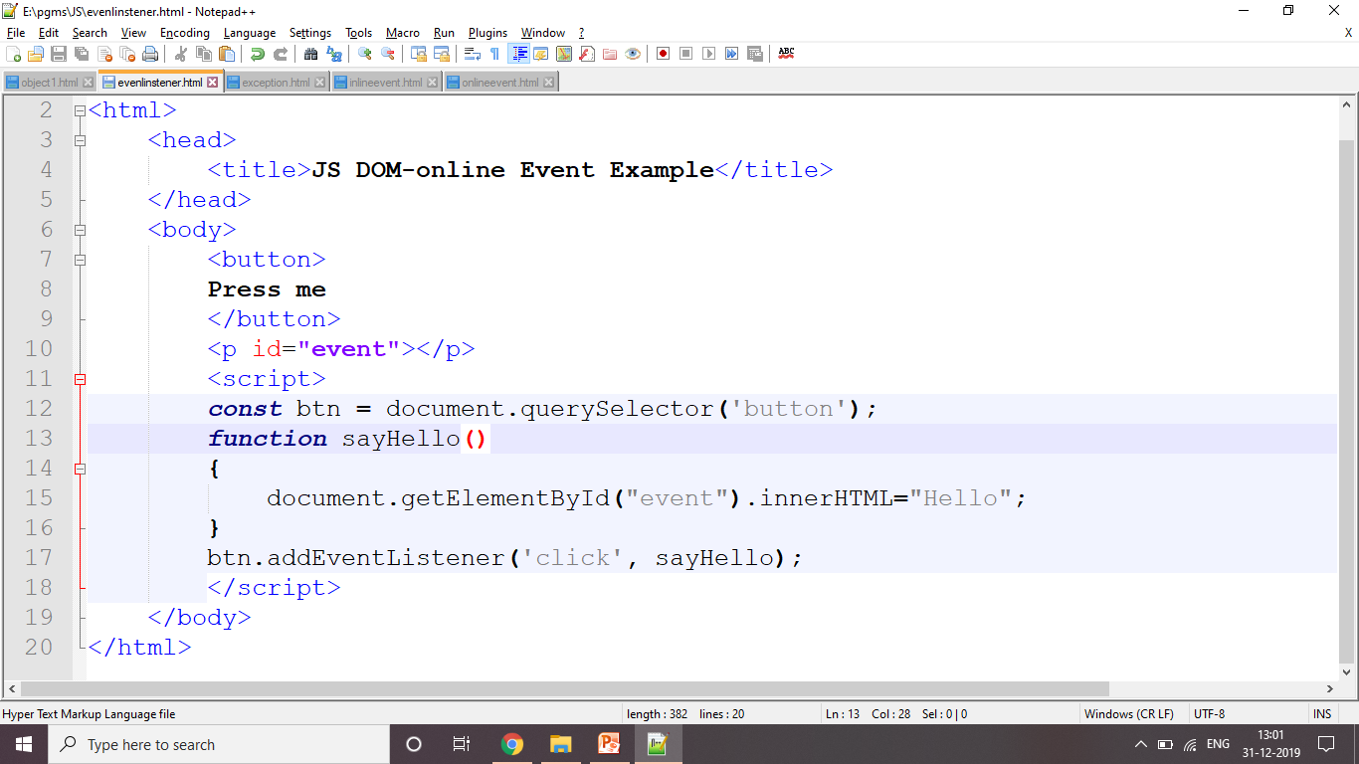
Using addEventListener()
<!DOCTYPE html>
<html>
<head>
<title>JS DOM-online Event Example</title>
</head>
<body>
<button>Press me</button>
<p id="event"></p>
<script>
const btn = document.querySelector('button');
function sayHello()
{
document.getElementById("event").innerHTML="Hello";
}
btn.addEventListener('click', sayHello);
</script>
</body>
</html>

Slide 79
Form Validation
<!DOCTYPE html>
<html>
<head>
<title>Form Validation</title>
<script>
function myFunction()
{
x = document.getElementById("age").value;
if (isNaN(x) || x < 1 || x > 120)
{
text = "Invalid Age";
}
else
{
text = "Input OK";
}
document.getElementById("status").innerHTML = text;
}
</script>
</head>
<body>
<p>Please Enter Your Age:
<input id="age">
<button type="button" onclick="myFunction1()">Submit</button></p>
<p id="status"></p>
</body>
</html>

Slide 80
Form Validation
<!DOCTYPE html>
<html>
<head>
<title>Form Validation</title>
<script>
function myFunction()
{
//var x, text;
x = document.getElementById("aadhar").value;
if (isNaN(x) || x.length!= 12)
{
text = "Invalid Number";
}
else
{
text = "Input OK";
}
document.getElementById("status").innerHTML = text;
}
</script>
</head>
<body>
<p>Please Enter Your Aadhar Number:
<input id="aadhar">
<button type="button" onclick="myFunction()">Submit</button></p>
<p id="status"></p>
</body>
</html>

Slide 81
DHTML
Dynamic HyerText Markup Language (DHTML) is a combination of Web development technologies used to create dynamically changing websites.
Web pages may include animation, dynamic menus and text effects.
HTML + JavaScript + CSS + DOM

Slide 82
DHTML Features
Dynamic content, which allows the user to dynamically change Web page content
Dynamic positioning of Web page elements
Dynamic style, which allows the user to change the Web page’s color, font, size or content

Slide 83
Difference between HTML and DHTML
TML (Hypertext Markup language) | DHTML (Dynamic Hypertext Markup language)
1. HTML is simply a markup language. | 1. DHTML is not a language, but it is a set of technologies of web development.
2. It is used for developing and creating web pages. | 2. It is used for creating and designing the animated and interactive web sites or pages.
3. This markup language creates static web pages. | 3. This concept creates dynamic web pages.
4. It does not contain any server-side scripting code. | 4. It may contain the code of server-side scripting.
5. The files of HTML are stored with the .html or .htm extension in a system. | 5. The files of DHTML are stored with the .dhtm extension in a system.
6. A simple page which is created by a user without using the scripts or styles called as an HTML page. | 6. A page which is created by a user using the HTML, CSS, DOM, and JavaScript technologies called a DHTML page.
7. This markup language does not need database connectivity. | 7. This concept needs database connectivity because it interacts with users.

Slide 84
JSON
JavaScript Object Notation
An open standard file format, and data interchange format,
Uses human-readable text to store and transmit data objects consisting of attribute–value pairs and array data types.
It is a very common data format, with a diverse range of applications, such as serving as a replacement for XML in AJAX systems.

Slide 85
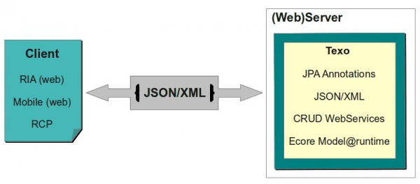
JSON
JSON is commonly used to exchange information between web clients and web servers.

Slide 86
JSON
a lightweight data-interchange format
It is easy for humans to read and write
It is easy for machines to parse and generate
It is based on a subset of the JavaScript Programming Language Standard
JSON is a text format that is completely language independent

Slide 87
JSON
JSON is built on two structures:
A collection of name/value pairs.
object, record, struct, dictionary, hash table, keyed list, or associative array
An ordered list of values.
array, vector, list, or sequence

Slide 88
JSON Syntax
JSON Syntax Rules
Data is in name/value pairs
":" to separate name from value
"," to separate name-value pairs
"{" and "}" for objects
"[" and "]" for arrays
Syntax:
{
"name" : "value“,
"name" : "value“
}

Slide 89
JSON Object Example
A JSON object is a key-value data format that is typically rendered in curly braces.
{
"color" : "Purple",
"id" : "210",
"composition" : {"R" : 70,"G" : 39,"B" : 89}
}

Slide 90
JSON Array Example
Data can also be nested within the JSON by using JavaScript arrays that are passed as a value using square brackets [ ] on either end of its array type.
{
"colors" :
[
{ "color" : "Purple", "id" : "210” },
{ "color" : "Blue", "id" : "211”},
{ "color" : "Black", "id" : "212” }
]
}

Slide 91
JSON Data Types
JSON consist of 6 data types
simple data types
string
number
boolean
null/empty
complex data types
object
array

Slide 92
JSON Example
{
"color" : "Purple“,
“id" : 210,
"visibility" : true,
"popularity" : null
}

Slide 93
JSON parse()
JSON parse() method deserializes a JSON string representation to a JavaScript object
The parse() method takes the JSON string, as received from API response and converts it a JavaScript object
Example:
var jsonString = '{ "x": 5, "y": 6 }';
var obj = JSON.parse( jsonString );
console.log(obj);

Slide 94
JSON stringify()
The JSON.stringify() function converts a JavaScript value to a serialized JSON string.
In other words, JSON.stringify() returns a JSON string corresponding to a JavaScript object.

Slide 95
<!DOCTYPE html>
<html>
<head>
<title>Stringfy() Example</title>
</head>
<body>
<div id="json1"></div>
<div id="json2"></div>
<script>
var obj = {
"fruit": "Apple",
"types": ["Small", "Medium", "Large"],
"quantity": 1000
};
var json_string = JSON.stringify(obj);
document.getElementById("json1").innerHTML = json_string;
try
{
var obj = JSON.parse(json_string);
document.getElementById("json2").innerHTML = obj.fruit + ", [" + obj.types + "], "
+ obj.quantity;
}
catch (e)
{
alert("Cannot parse given string");
}
</script>
</body>
</html>

Slide 96
JSON Function Files
Create an array of objects in external js file
Create a JavaScript function with same name as external javascript file having array of json objects to display the array.
Use an array literal as the argument
Add the external script

Slide 97
JSON Function Files
<!DOCTYPE html>
<html>
<body>
<div id="content"></div>
<script>
function myFunction(arr)
{
var out="";
for(i = 0; i<arr.length; i++)
{
out += arr[i].name +" "+ arr[i].department+"<br>";
}
document.getElementById("content").innerHTML = out;
}
</script>
<script src="myjson.js"></script>
</body>
</html>
myjson.js
myFunction([
{
"name": "Madan",
"department": "cse"
},
{
"name": "Suresh",
"department": "ece"
},
{
"name": "Muthu",
"department": "eee"
},
]);

Slide 98
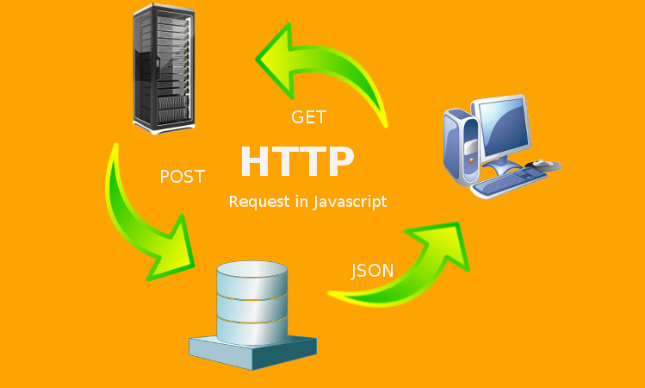
JSON HttpRequest

Slide 99
JSON HttpRequest
<!DOCTYPE html>
<html>
<head>
<title>JSON HttpRequest Example</title>
</head>
<body>
<h2>JSON HttpRequest Example</h2>
<button type="button" onclick="readJSON()">Show JSON</button>
<p id="jsonstring"></p>
<script>
function readJSON()
{
var xhttp = new XMLHttpRequest();
xhttp.onreadystatechange = function()
{
if (this.readyState == 4 && this.status == 200)
{
document.getElementById("jsonstring").innerHTML = this.responseText;
}
};
xhttp.open("GET", "student1.json", true);
xhttp.send();
}
</script>
</body>
</html>
student1.json
[
{
"name": "Madan",
"department": "cse"
},
{
"name": "Suresh",
"department": "ece"
},
{
"name": "Muthu",
"department": "eee"
},
]);

